Slide 1

BUSINESS DATA MANAGEMENT CAPSTONE PROJECT Optimizing Business Model of a Local Grocery Shop Name – Om Aryan Roll no. – 21F3002286

Slide 2
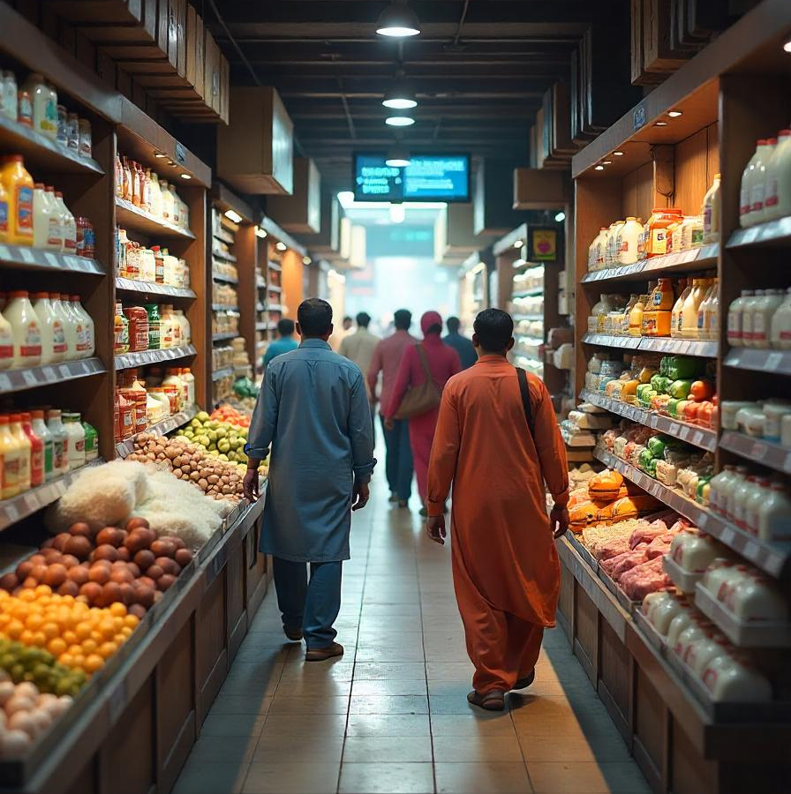
Project Overview
The project examines the business challenges of “The Need Shop”, a small grocery shop located in Faridabad, Haryana, which sells basic products of daily needs to the local inhabitants.
This project delves into the issues through various studies projecting different aspects of the issue.
The report also lists the methods of analysis employed and recommendations to the business addressing the issues for a small-sized business like The Need Shop.

Slide 3
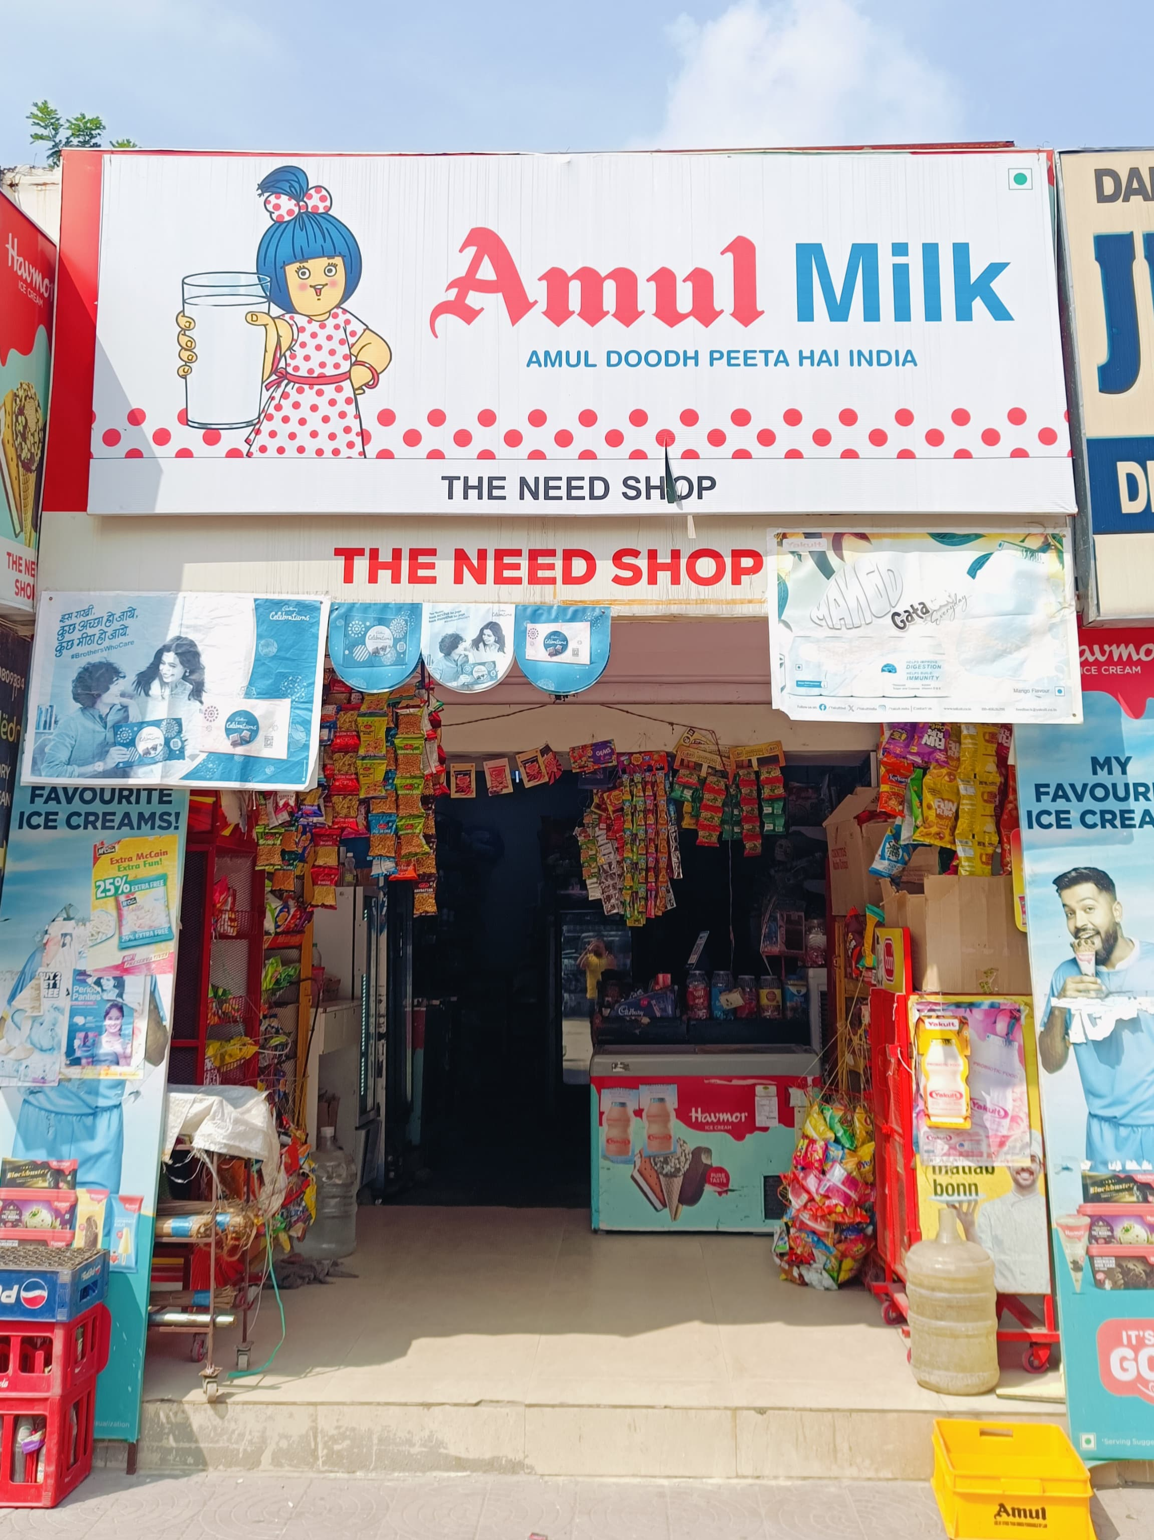
Business Background
The Need Shop is a small grocery shop owned by Mr. Sunil Kumar and started in 2008 in Faridabad, Haryana.
The store serves the residents with a wide range of essential items. and mainly conducts business in a B2C format.
Grocery stores face a number of key challenges that impede growth and profitability.
It is located in a residential area where people have easy access and can easily walk in and buy daily necessities and household goods.

Slide 4

Challenges and Objectives
Convergence of online platforms and supermarkets
Increased supplier costs and reduced profit margins
Human resources and operations challenges

Slide 5
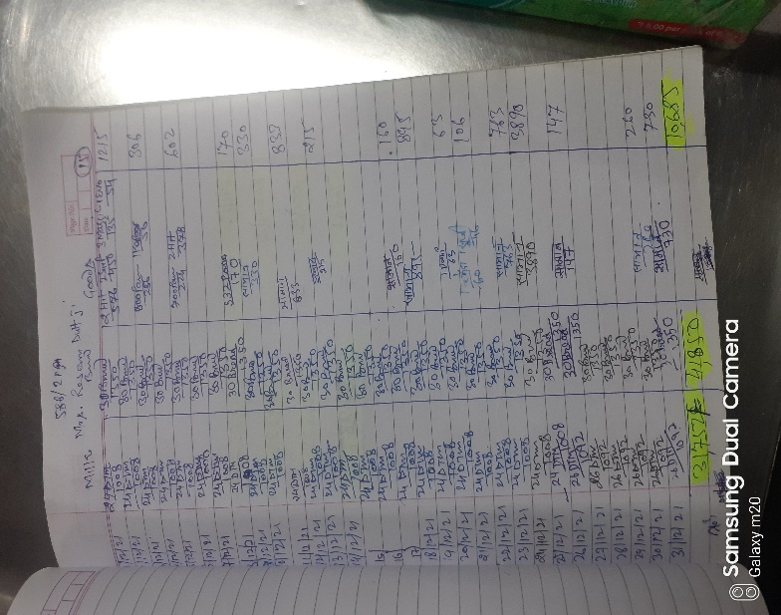
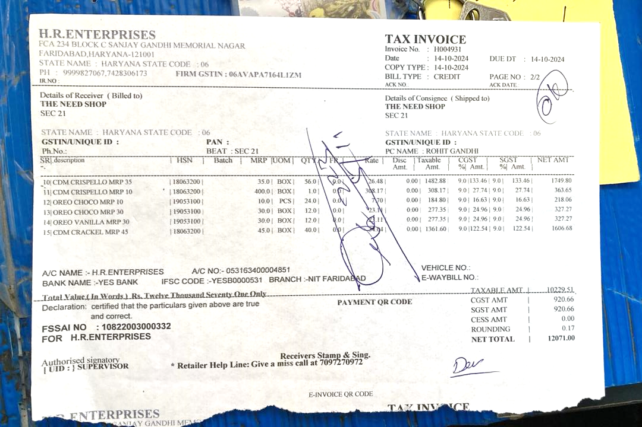
Data Analysis and Methodology
Data Collection: The primary data collection process developed by engaging the owner of the business in a series of meetings and discussions which paved the way for the understanding business’ working model deeply. The sales and purchases are only tracked informally in form of hand-written logs by the business as sampled in the given image.
Data Cleaning and Analysis: The handwritten information provided by the business is transformed into structured format in excel consisting of digital sheets manually for the purpose of enabling further analysis and interpretation of the information.

Slide 6
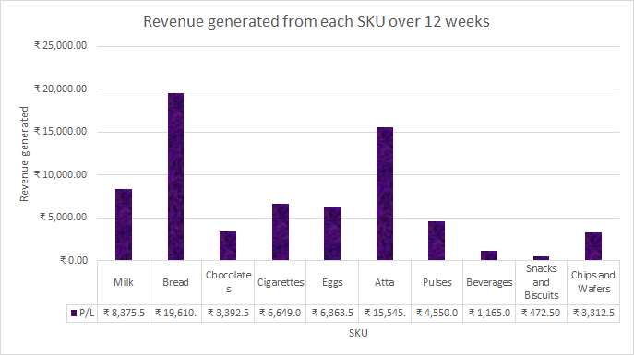

Slide 7
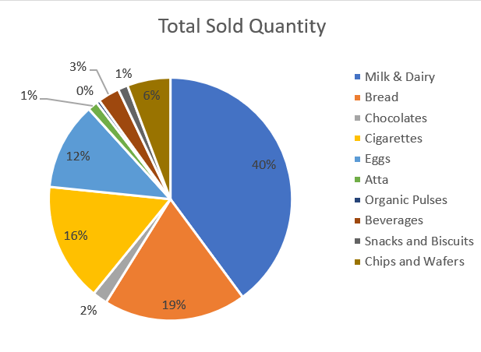

Slide 8
Results and Findings
Milk and Dairy products are the most bought SKU which accounted for 40% of the total sales quantity.
Atta accounts for merely 1% of the sales quantity yet comes third in the revenue due to its high price, making it a key item for profitability.
High margin products such as Atta and Organic Pulses all offer lucrative opportunities sensibly despite having less demand.
There is no need to hold an excessive quantity of low demand products like Snacks and Biscuits which have low sales and low profit percentage.

Slide 9
Recommendations
Increase the Sales of High-Profit Items
Business-to-Business (B2B) partnerships
Bulk Discounts
Optimize Inventory for Underperforming Items
Targeted Promotions
Adjust Inventory Levels
Replace Low-Performing SKUs
Focus on High-Sales but Low-Profit Items
Morning Sales Strategy
Home Delivery
Subscription Services
Additional Recommendation for smooth operations and increased footfall
Bundle Pricing
Promotional Pricing
Eye-Catching Displays

Slide 10
Conclusion
By addressing the issues faced by the business with tailored solutions, the shop can overcome current challenges, optimize operations, and ensure long-term financial sustainability. The implementation of these recommendations will enable the business to thrive in a competitive environment, retain customers, and achieve its profitability goals.
I’m open to questions!
Project link: 🔗

